Slide 1
Pacific Garbage Patch Cleanup C3

Slide 2





Team C3
Jake Goodman
Document Manager
Salman Alotaibi
Web Designer
Stephen Sauder
Project Manager
Mohammad Alajmi
Budget Liaison
Nader Alajmi
Client Contact
2

Slide 3
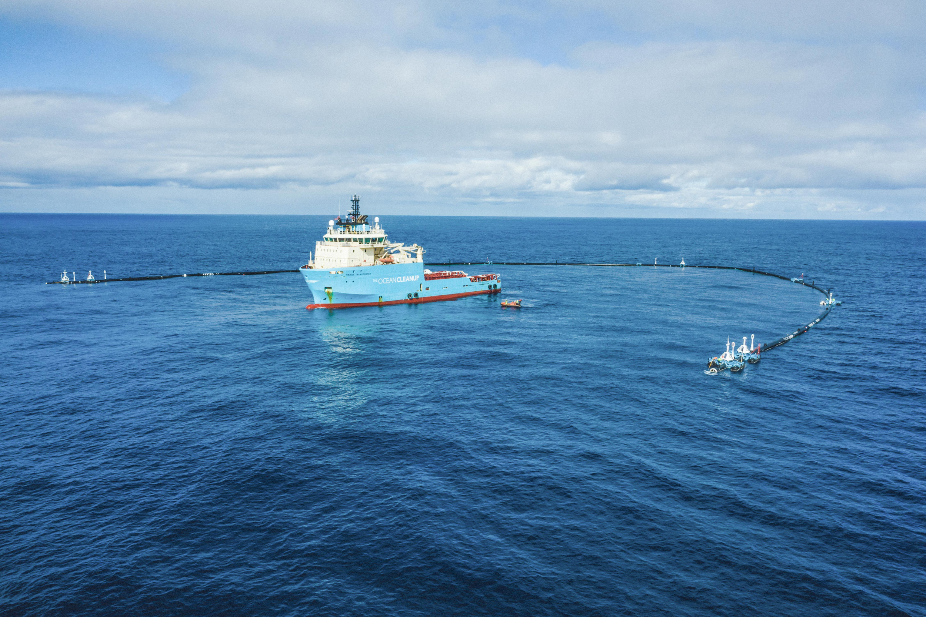
The Ocean Cleanup Inspiration
Boyan Slat
2013
Clean ocean
San Francisco
Estimated 50% in 5 years
Figure 1: Boyan Slat Project
Nader Alajmi 3

Slide 4
Project Description
Due to trash collecting in the oceans, the team is tasked with creating an autonomous device that can identify, locate, and collect plastic trash. To model a larger scale boat in the ocean, a RC boat will be modified to autonomously collect ping pong balls.
Nader Alajmi 4

Slide 5
Garbage Patch Background
10 mm up to undecomposed large material
Transfers through the food chain
Floating layer
Spans 1.6 x 10⁶ km²
  Roughly 2.5 times the size of Texas
Jake Goodman 5

Slide 6
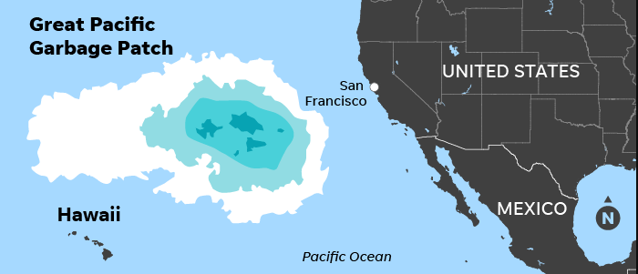
Figure 2: Pacific Garbage Patch
Jake Goodman 6

Slide 7
Requirements
Customer Requirements
Does not damage the ecosystem
Autonomous
Solar Powered
Collects 20 ping pong balls
Sensors
Effectiveness
Fast
Waterproof
Engineering Requirements
Under 20kg
90% plastic removal
<50W of power
Speed of boat >10 m/s
Collect 20 ping pong ball
Lasts 5 years
Mohammad Alajmi 7

Slide 8
Design Goals
Objectives
Collection
Storage
Continuous Collection
Locating plastic
Solutions
Motorized scoop in front of device
Net container under platform
Solar Panels
Platform for sufficient exposure
Camera with arduino to take pictures on minute intervals
Salman Alotaibi 8

Slide 9
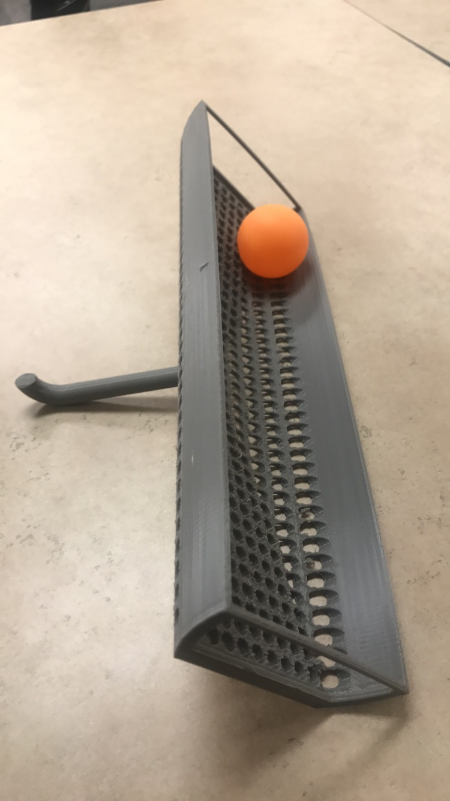
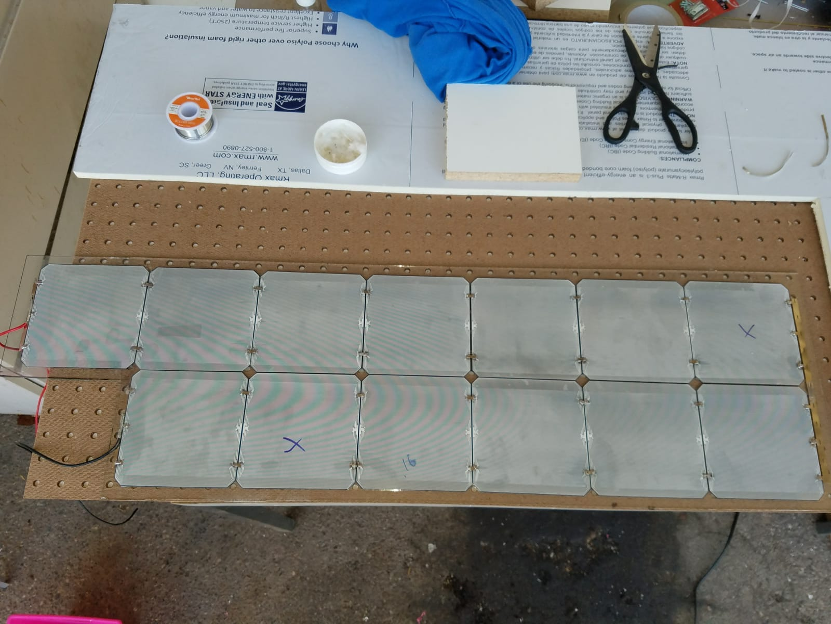
Previous Designs
Figure 3: Grabber
Figure 4: Solar cells
Salman and Stephen 9

Slide 10
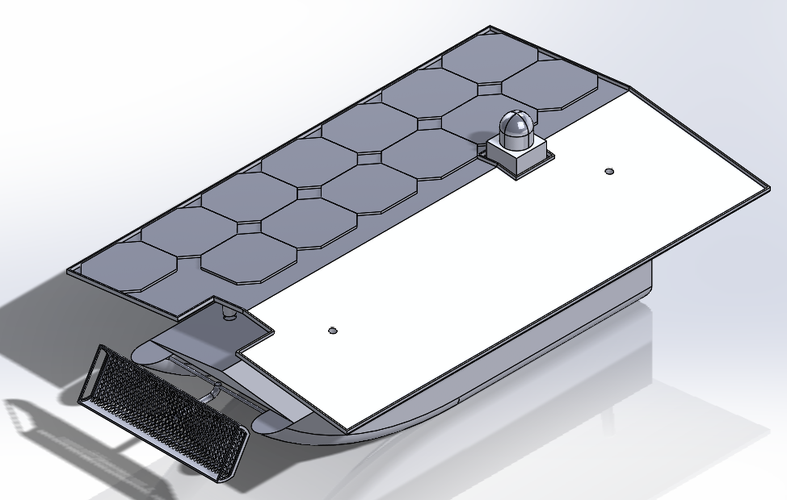
CAD Model
Solar Panels
Camera
Platform
Boat
Figure 5: Fully Assembled CAD Model
Salman Alotaibi 10

Slide 11
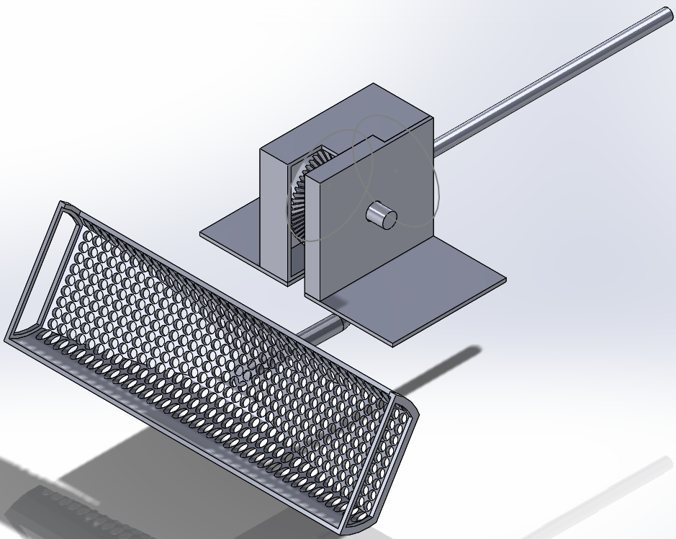
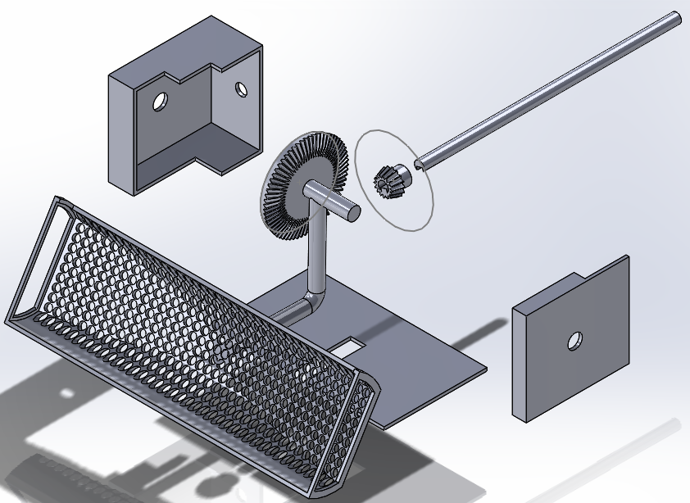
Grabber Assembly CAD
Pinion
Gearbox
Final CAD Drawn Parts
Shaft
Gearbox Platform
Grabber
Figure 6 & 7: Grabber Assembly CAD
Stephen Sauder 11

Slide 12
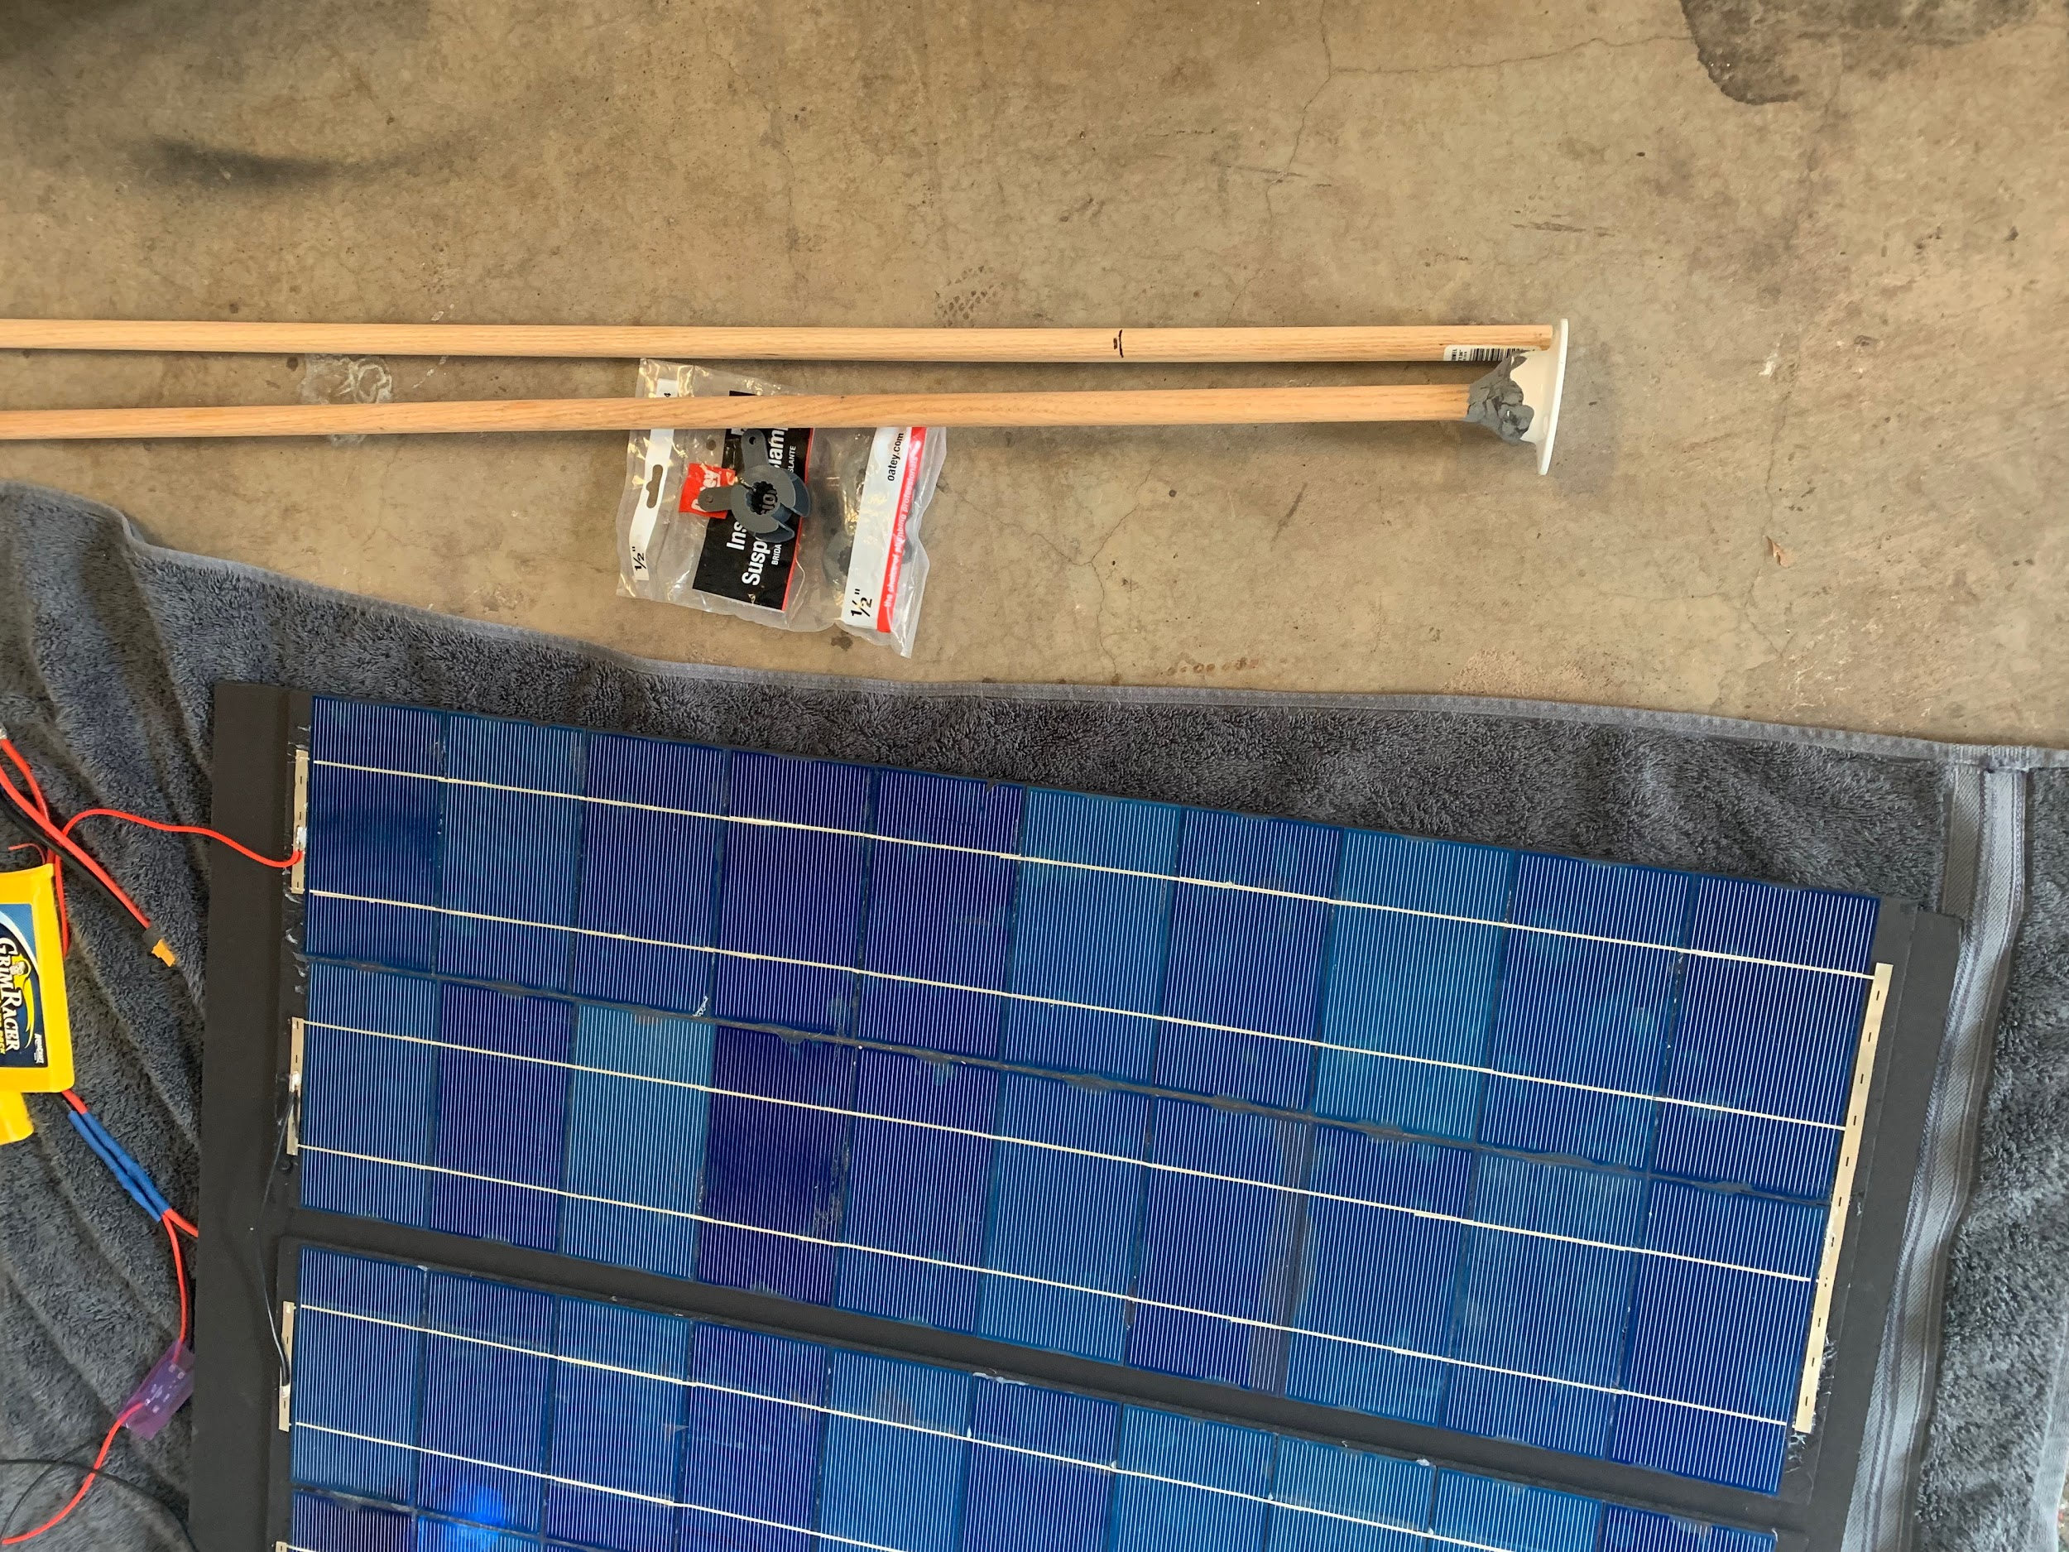
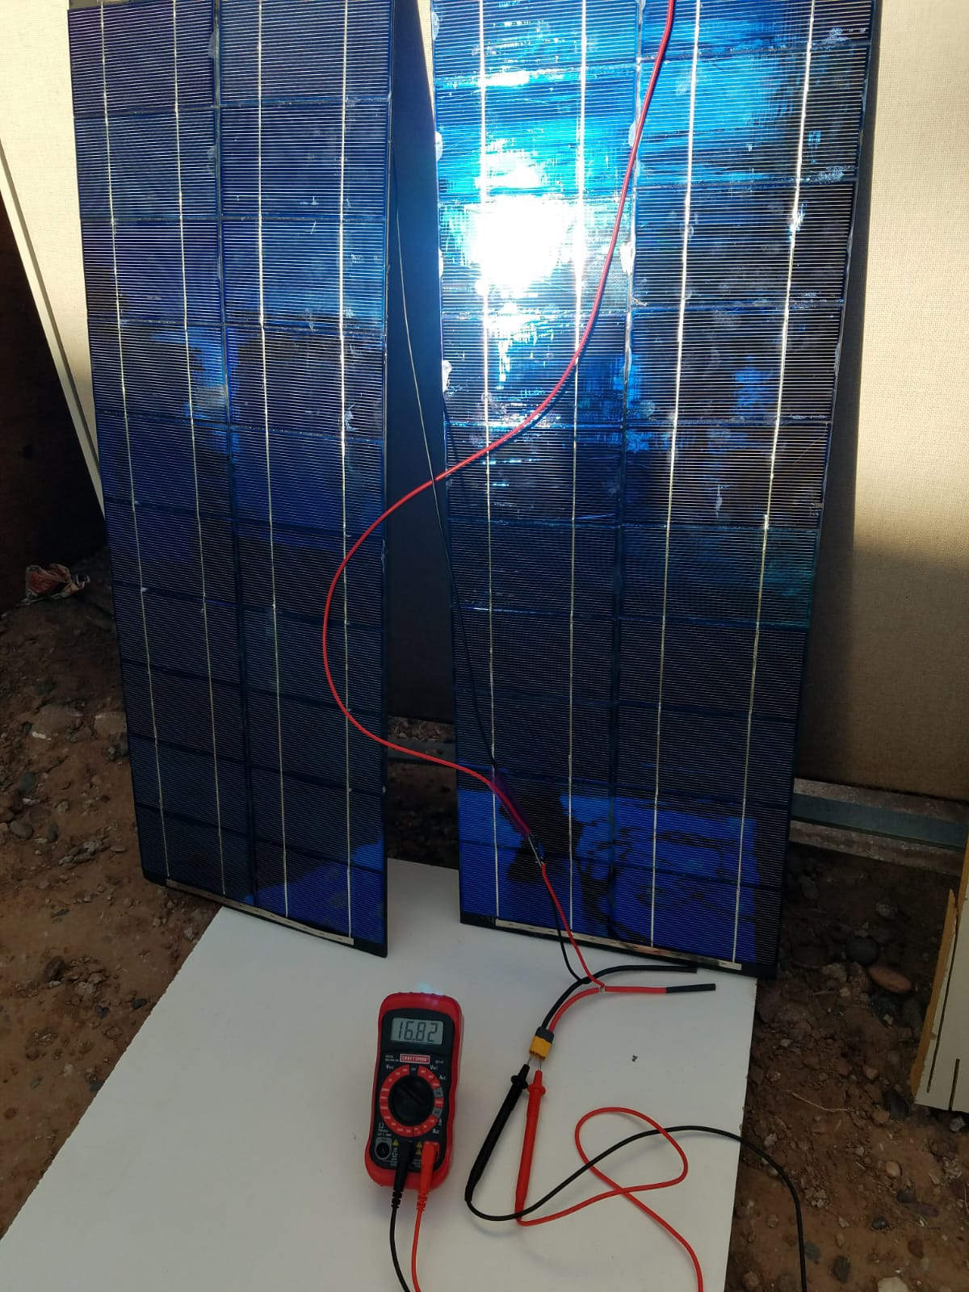
Platform & SP Testing
Platform
DC converter
Solar Panels
Stick
Figure 8: Voltage testing
Figure 9: SP & Platform
Salman Alotaibi 12

Slide 13
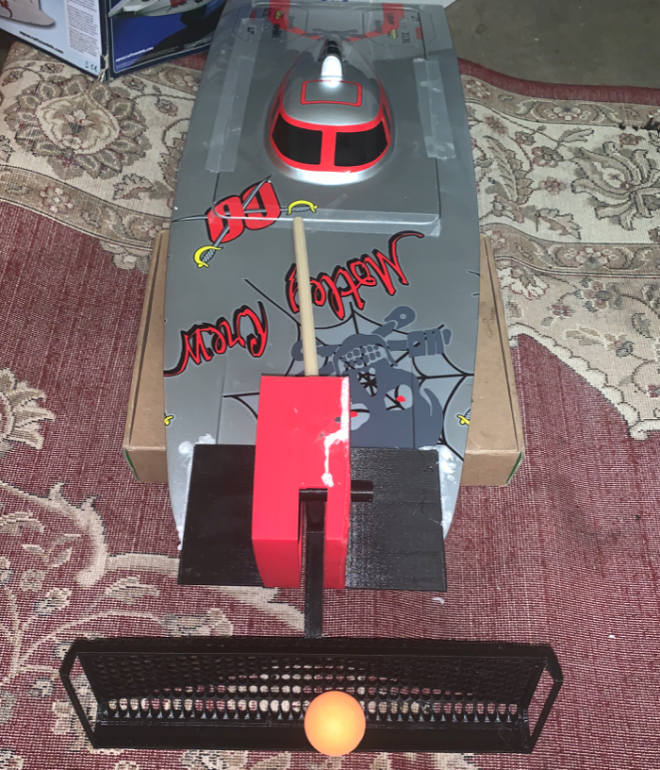
Updated Design Picture
Stephen Sauder 13
Figure 10: Design Picture

Slide 14
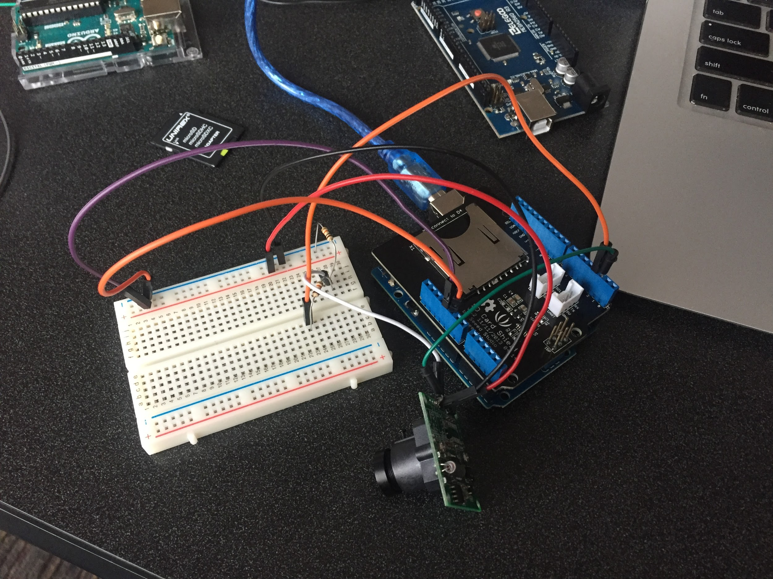
Camera Testing
Figure 11: Arduino Testing
Nader Alajmi 14

Slide 15
Testing
To meet goals, the device is divided into the following:
Solar panel mounted platform charges batteries
Activating the motor attached to the grabber with a remote control, scoops a ping pong ball from the water into the net storage container
Camera equipped with arduino, takes and saves a photo every minute to an attached SD card
Mohammad Alajmi 15

Slide 16
Future Work
Identify ping pong balls in pictures
Navigate to located ping pong ball using software
Connect the grabber motor to the receiver to run it
Install the platform on the boat and a net container
Stephen Sauder 16

Slide 17
Conclusions
The final device is potentially an effective solution to clean up the Pacific Garbage Patch in a cheap and efficient manner.
Stephen Sauder 17

Slide 18
What We Learned
The iterative engineering design process
Soldering solar panels and wires.
Arduino
Nader Alajmi 18

Slide 19


Acknowledgements
NAU Sponsor: Dr. Trevas
Mohammad Alajmi 19

Slide 20
References
Ocean Cleanup, “The Ocean Cleanup, The Ocean Cleanup. [Online]. Available: https://www.theoceancleanup.com [Accessed: 26-Apr-2019].
G. Wiszniewski, “Clean Our Oceans: The Impact of the Great Pacific Garbage Patch,” Busy Bee Cleaning Service, 09-Apr-2018. [Online]. Available: https://www.bbcleaningservice.com/great-pacific-garbage-patch.html. [Accessed: 20-Apr-2019].
D. Rice, “World's largest collection of ocean garbage is twice the size of Texas,” USA Today, 28-Dec-2018. [Online]. Available: https://www.usatoday.com/story/tech/science/2018/03/22/great-pacific-garbage-patch-grows/446405002/. [Accessed: 24-Apr-2019].
20

Slide 21
Any Questions?
21

